Slide 1
Sega Dreamcast Visual Memory Unit FPGA Implementation
by
Falco Girgis
4/25/17
CPE526

Slide 2
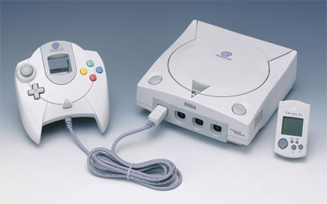
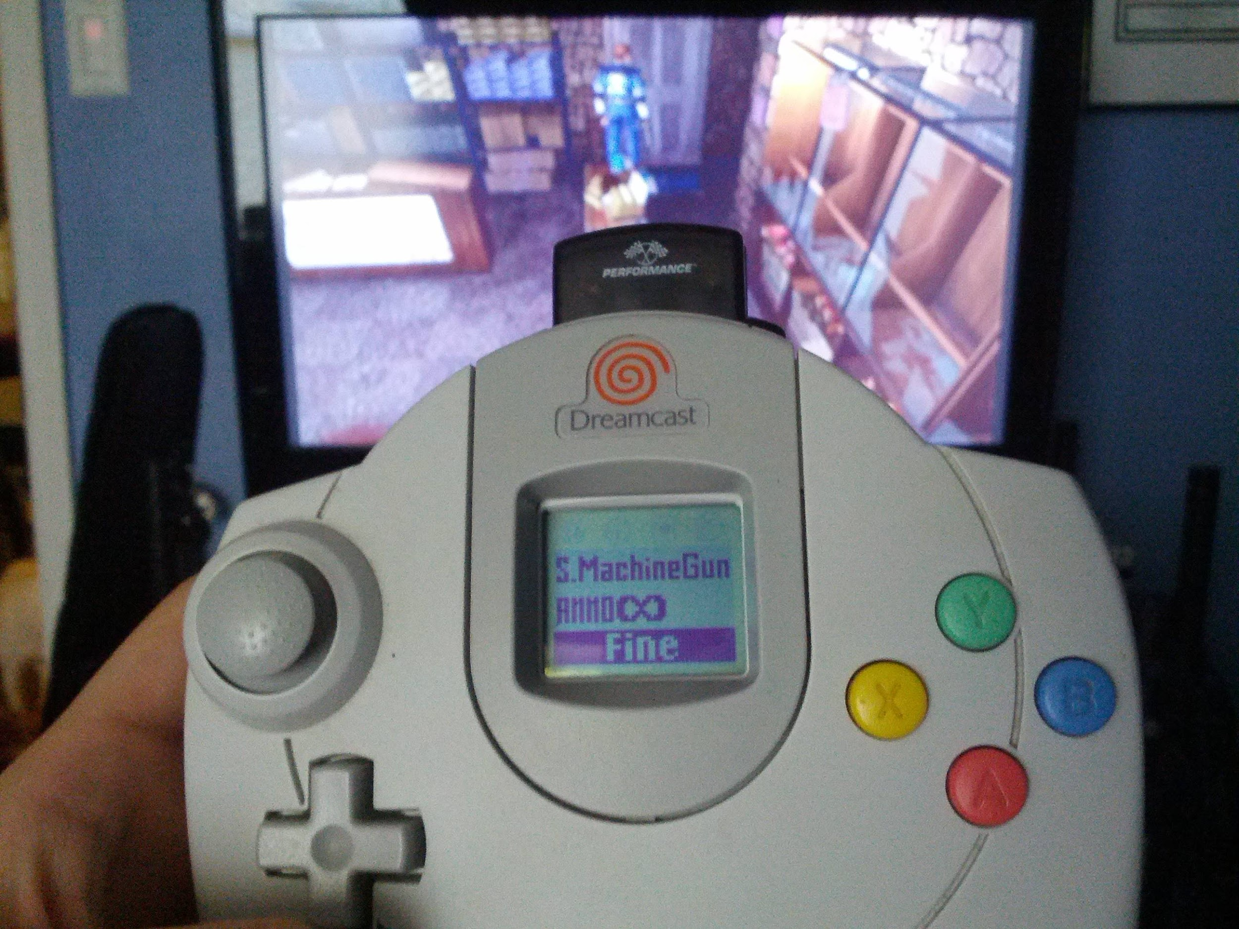
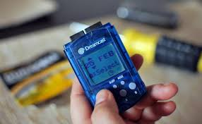
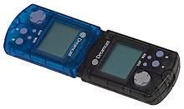

Visual Memory Unit (VMU)

Slide 3
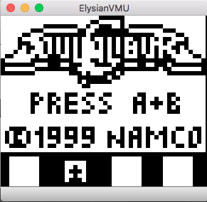
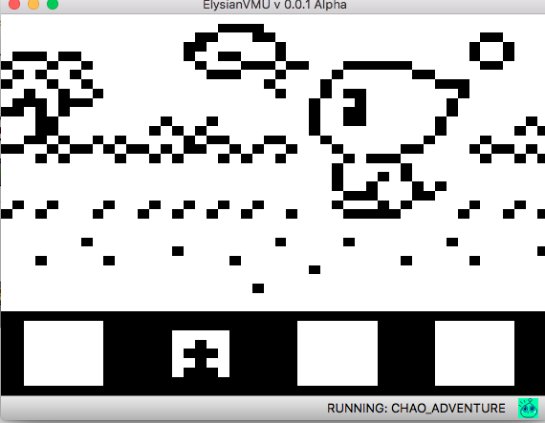
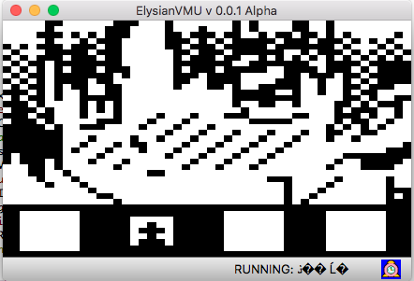
Cross-Platform VMU Support
Elysian Shadows Kickstarter (Indie 2D/3D RPG)
  Windows, Mac, Linux, Sega Dreamcast, Steam, iOS, Android, OUYA, ForgeTV, RaspPi
  Dreamcast-specific VMU content for display and minigames
ElysianVMU Software Emulator
  Play VMU content on any device

Slide 4
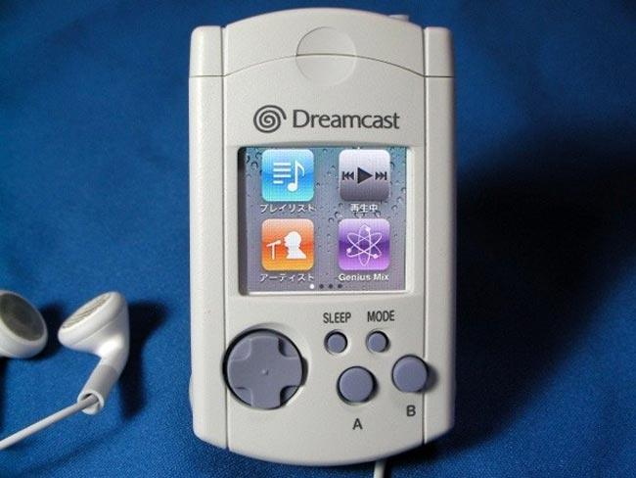
Next Generation VMU Hardware (VMU2?)
PC Communication
USB Storage Device
Larger Memory Capacity
Chargeable Batteries
Backlit LCD
Higher Resolution
Color
High-Quality Audio Output
16-bit ISA
Backwards Compatibility

Slide 5
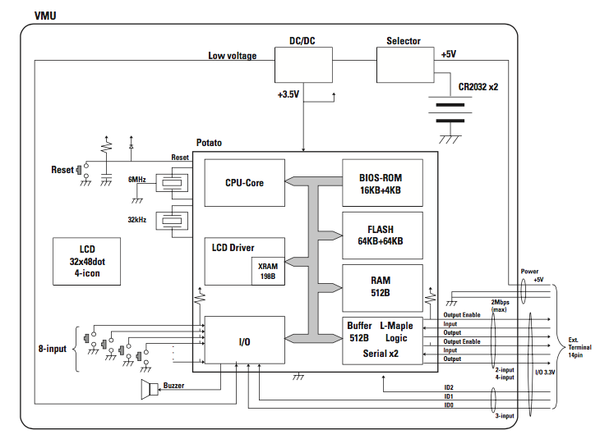
System Block Diagram

Slide 6
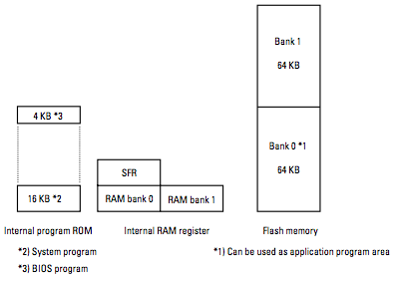
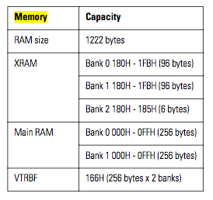
Memory Layout
Memory Space RAM Space

Slide 7
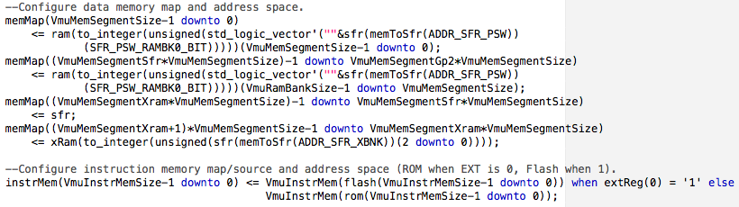
Memory Mapping in VHDL

Slide 8
8-bit Sanyo LC86K87 CPU Features
128-KB Flash memory
20-KB ROM
710-byte RAM
13-source, 10-vector interrupt architecture
LCD Controller/Driver
16-bit timer/counter/pulse generator
16-bit (or 2-channel x 8-bit) synchronous serial interface
Dedicated Dreamcast interface

Slide 9
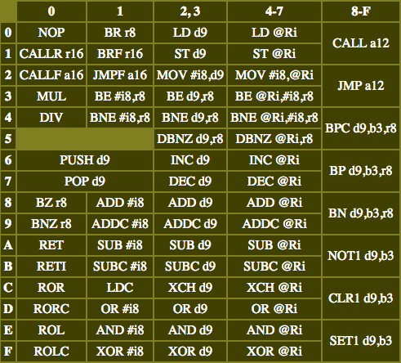
Instruction Map

Slide 10
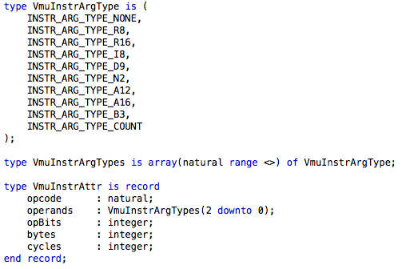
VHDL Instruction Attribute Record

Slide 11
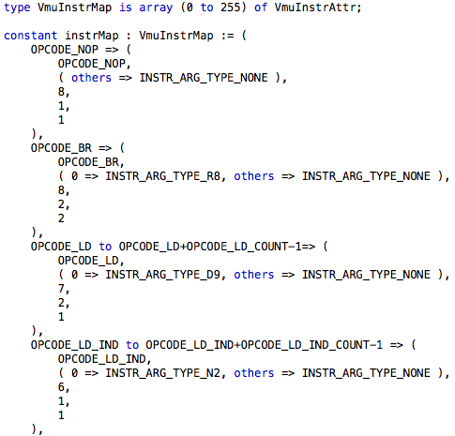
VHDL Instruction Attribute Lookup Table

Slide 12
VHDL CPU Core Logic
Clock Process
  Update program counter
  Handle reset signal and logic
Fetch Instruction
Extract Operands
Fetch Register Indirect Pointer Operand
Execute Instruction

Slide 13
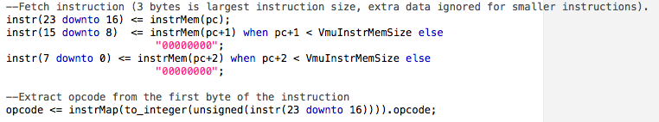
1 - Fetch Instruction

Slide 14
2 - Extract Operands
Decode instruction for operand types
Extract operands from instruction
  Types and packing determined by address modes
  2 Different Cases
    Specially-coded Instructions
      Hard-coded logic
    Standard-encoded instructions
      Standard loop (3 possible operands)

Slide 15
Addressing Modes
Mode | Bits | Description
Immediate | 8 | Operand given in instruction
Direct | 9 | Address of operand in memory
Indirect | 2 | Index of a special pointer register in memory which contains the address of the operand.
Bit specifier | 3 | Specifies a bit offset within a byte operand
Absolute | 12/16 | 12 or 16 bits of PC are set to the given address
Relative | 8/16 | Address encoded is added to PC

Slide 16
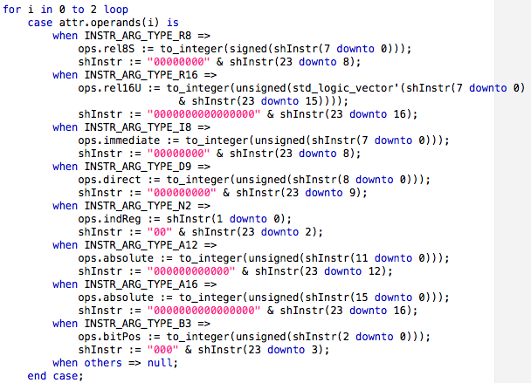
VHDL General-Case Operand Extraction Logic

Slide 17

3 - Fetch Register Indirect Operand Pointer
Not straightforward
  8-bit words, 9-bit addresses
  Pointers stored in special preset addresses
  Address Calculation
    Bit 8: MSB of ptr reg index (from instruction)
    Bit 7 downto 0: Value stored in the given ptr reg

Slide 18
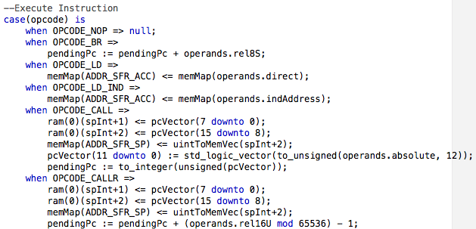
4 - Execute Instruction
Weirdly easy

Slide 19

C vs VHDL Opcode Implementation
C
VHDL

Slide 20
Future Work (Playable)
Feed display buffer to graphics display
  XRAM is ready
Wire controller/input buttons
  Port 3 logic is implemented and ready
Work RAM
Timer0 and Timer1

Slide 21
Questions?

